Slide 1








Year 8 Spring 1
CURRICULUM NEWSLETTER
MATHS
SCIENCE
.
During this half term, the pupils will be learning about the process of digestion. They will explain the parts of the digestive system, understand what a balanced diet is and what different nutrients they require. After digestion, the pupils will learn all about the benefits and harmfulness of drugs on the body.
This half term in Year 8, pupils will develop their understanding of geometry, algebra and percentages, strengthening key skills and applying them to a range of problem-solving contexts.
In geometry and measures, pupils will name and classify 2-D and 3-D shapes, calculate the area of simple and compound shapes, and recognise prisms, using correct language such as faces, edges and vertices. They will calculate the volume of cubes and cuboids, convert between metric units of mass and capacity, and solve problems involving density, mass and volume.
In algebra, pupils will solve one- and two-step equations, progressing to more complex and fractional equations. They will form equations from problems, solve equations with unknowns on both sides, and develop understanding of inequalities, including representing and solving them on a number line.
In percentages, pupils will calculate percentages of amounts, convert between percentages and decimals, and use multipliers to find percentage increase and decrease, including values greater than 1.
ENGLISH
The pupils are nearing the end of their study of Charles Dickens’s A Christmas Carol and will soon be exploring the topic ‘Speeches of Power and Protest’. This unit provides them with the opportunity to explore influential speeches by significant figures including Martin Luther King, Malala Yousafzai, Nelson Mandela, Emmeline Pankhurst and Emma Watson, to name but a few! Along the way, they will build upon their analytical skills to examine these speeches in detail, and they will also have the opportunity to compose their own powerful speeches.

Slide 2







MFL - SPANISH
This half term, Year 8 will begin the topic of “Una vida sana”. In this topic, they will begin by naming key foods and drinks and linking these to different meals. Using the present tense, they will say what they eat and use past knowledge of opinions to express their likes and dislikes. When looking at meals, they will identify in Spanish which food choices are healthy and unhealthy through looking at authentic nutritional content in Spanish.
HISTORY
During this term, pupils will study the Industrial and Agricultural Revolutions, key inventions, urban migration and living conditions, political radicals, the Great Reform Act, social change in Britain, and Jack the Ripper’s crimes.
GEOGRAPHY
Pupils will study Climate Change, exploring how the Earth’s climate has changed throughout history and how it is changing today. They will investigate the causes of climate change, examine the evidence scientists use, and consider its effects on people and the planet. Pupils will also explore ways to manage and respond to these changes, developing an understanding of how individuals, communities, and countries can help create a more sustainable future. This unit encourages critical thinking and awareness of global environmental challenges.

Slide 3





P.E
Throughout this half term, Year 8 will be developing their leadership and communication skills within Sports Leadership as they teach each other sports and create games to teach younger students. They will also develop their understanding of exercise and why it is important to live a healthy lifestyle in Health, Fitness and Wellbeing.
R.E
DESIGN AND TECHNOLOGY
This half term, Year 8 will be finishing the topic ‘Significant People’ before starting the topic, ‘Significant Events’. This topic involves the understanding of how beliefs, values and worldview are shaped by history.
During this term year 8 will be starting their textiles module, they will be gaining inspiration from Lucy Sparrow to design and make their own Supermarket Stitch themed cushion. Learning how to make their own templates, applique shapes with hand sewing techniques and use the sewing machine/embroidery machine.

Slide 4

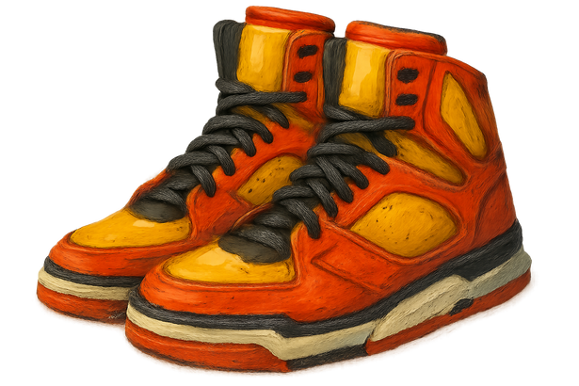



ART
ART
Continuing on from Portraiture students will be looking at the topic of Fauvism in order to develop their colour theory and mixing skills, with a particular focus on cool and warm colours. We will be learning about the art movement dubbed “The wild beasts” to develop our painting skills beginning with creating an artists copy.
COMPUTING
PSHE & RSE
Creating a Mobile App
Pupils learn to code a mobile app. Pupils will learn how to use event driven programming to create functionality in their app. Learners will then create a clicker app using these skills.
This half term year 8 will learn about income and money choices- looking at how they can track spending and how incomes vary across the world.

Slide 5

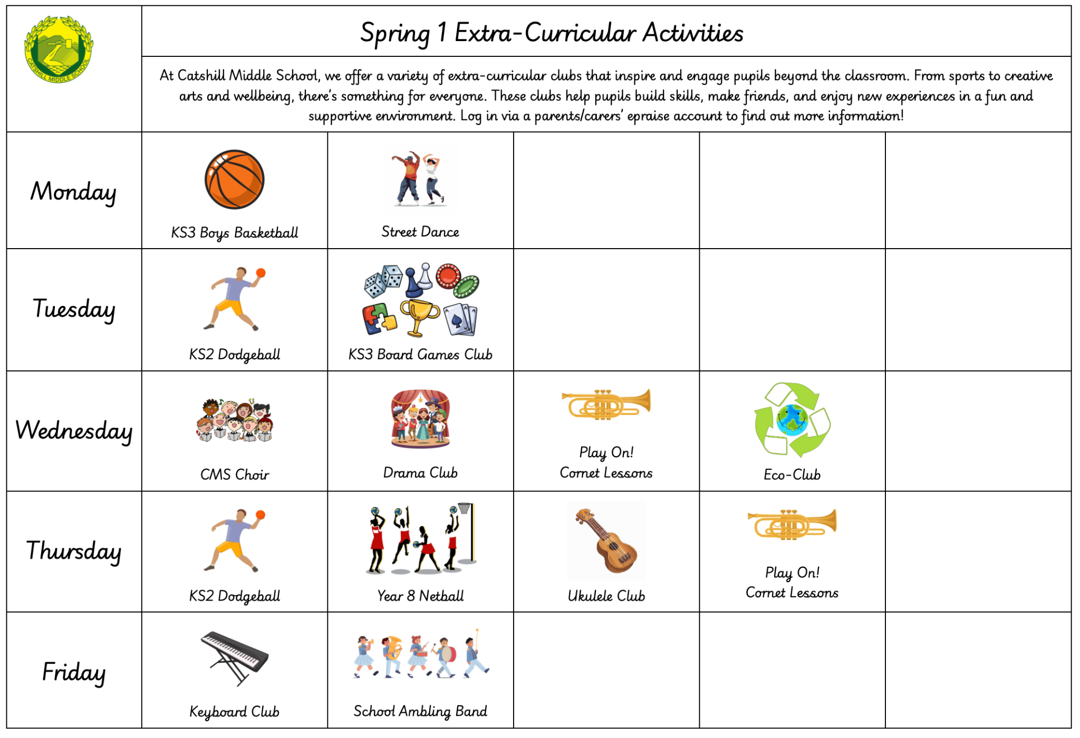

MUSIC
This term, year 8 will be delving into the world of music as a tool in the media, utilising DAW, Bandlab. They will learn about the power of the pentatonic scale to explore jingle writing, explore conventions of radio adverts and trailers, and consider the psychological effect of synergy to sell products.
CAREERS
HOMEWORK
Year 8 will be involved in a day of workshops with an external inspirational speaker to boost self-awareness, purpose, accountability, resilience, and confidence. They will also have the opportunity to visit the Worcester Skills Show at Sixways Stadium.
In Year 8, pupils will be set weekly homework. This will include:
A piece of Maths homework
A piece of English homework
Spellings
We also expect pupils to read for a minimum of three times per week at home.
Other subjects will set additional homework to aid learning outside of the classroom when needed. This will be added onto epraise.
EXTRA-CURRICULAR
From sports to creative arts and wellbeing, there’s something for everyone. Clubs help pupils build skills, make friends, and enjoy new experiences in a fun, supportive environment. Log in via a parents/carers’ epraise account to learn more.

