Slide 1








Year 7 Spring 1
CURRICULUM NEWSLETTER
MATHS
SCIENCE
During this half term in Year 7, pupils will develop key skills in data handling and number, building on prior learning while preparing for more advanced mathematical thinking.
In statistics, pupils will learn how to present and interpret data using pictograms, bar charts (including dual and composite charts) and time series graphs. They will plot coordinates in the first quadrant, explore scatter graphs, and understand correlation and lines of best fit, including recognising non-linear relationships. Emphasis will be placed on interpreting data and drawing sensible conclusions.
In number, pupils will strengthen their understanding of fractions, decimals and percentages. They will represent tenths, hundredths and thousandths, place values on number lines, and explore equivalent fractions. Pupils will convert between fractions, decimals and percentages, compare and order values, and understand fractions as division, including values greater than 1.
During this half term, the pupils will be studying the solar system and beyond. They will be looking at the Earth’s place within the solar system and also study the different planets. They will then study the rock cycle before looking at the concept of energy.
ENGLISH
This term, Year Seven will revisit classic fairy tales through a more mature lens in their Twisted Tales unit. Pupils will explore contemporary retellings of familiar childhood stories by authors including Philip Pullman, Angela Carter, Neil Gaiman, Shaun Tan, and Gregory Maguire, discovering how traditional tales can be reshaped in surprising and thought-provoking ways.
Through shared reading, discussion, drama, and creative writing, pupils will develop their reading comprehension skills while exploring darker themes, alternative viewpoints, and imaginative storytelling.

Slide 2







MFL - SPANISH
This term we begin our topic “Un viaje por Barcelona”, where we will learn about the city of Barcelona and all it has to offer. We will learn how to name places of interest in Spanish and describe what there is is to visit in the city. We will also learn how to say what we will do in those places if we visit, using the future tense. Our listening and reading skills will be developed through the use of authentic materials about Barcelona.
HISTORY
During this term, pupils will learn about empire, Silk Road trade, Black Death origins, spread, symptoms, treatments, impacts on towns and feudalism, and the Peasants’ Revolt’s causes, events, suppression, and consequences in England.
GEOGRAPHY
Year 7 pupils will study Depleting Resources, looking at how natural resources like water, minerals, and energy are being used up. They will explore the causes of resource depletion, the impact on people and the environment, and ways to manage and conserve resources for the future. This topic helps pupils understand the importance of sustainable use and the challenges of meeting the needs of a growing population.

Slide 3





P.E
Throughout this half term, Year 7 will be discussing why we take part in physical activity and the benefits living healthily has on their bodies within Health, Fitness and Wellbeing. They will have the opportunity to create sports specific workout circuits and begin to take part in different types of exercise.
R.E
DESIGN AND TECHNOLOGY
This half term, Year 7 will be continuing and finishing the topic ‘God’ before starting the topic, ‘Eastern Religions’. This topic involves the exploration of Eastern diversity, tradition, assumption and morality.
During this term year 7 will be building their skills in the workshop starting the Skills Stand project. They will have the opportunity to design and make their own phone or book stand using nine different techniques to construct and decorate it.

Slide 4





ART
ART
After completing our stop in Impressionism, we are now moving to another major art movement, Cubism! Students will delve into the world of forms broken down into geometric shapes and the well known term of ‘abstraction’. They will be creating artworks that break down everyday objects as well as working on collaborative portraits.
COMPUTING
PSHE & RSE
Sequence and Selection
The aim of this unit and the following unit (P.E 2) is to build learners’ confidence and knowledge of the key programming constructs. The main programming concepts covered in this unit are sequencing, variables, selection, and count-controlled iteration.
Whilst exploring their dreams and goals, this half term year 7 will learn how they can overcome challenges. They will explore how risky or unsafe choices can affect your goals.

Slide 5

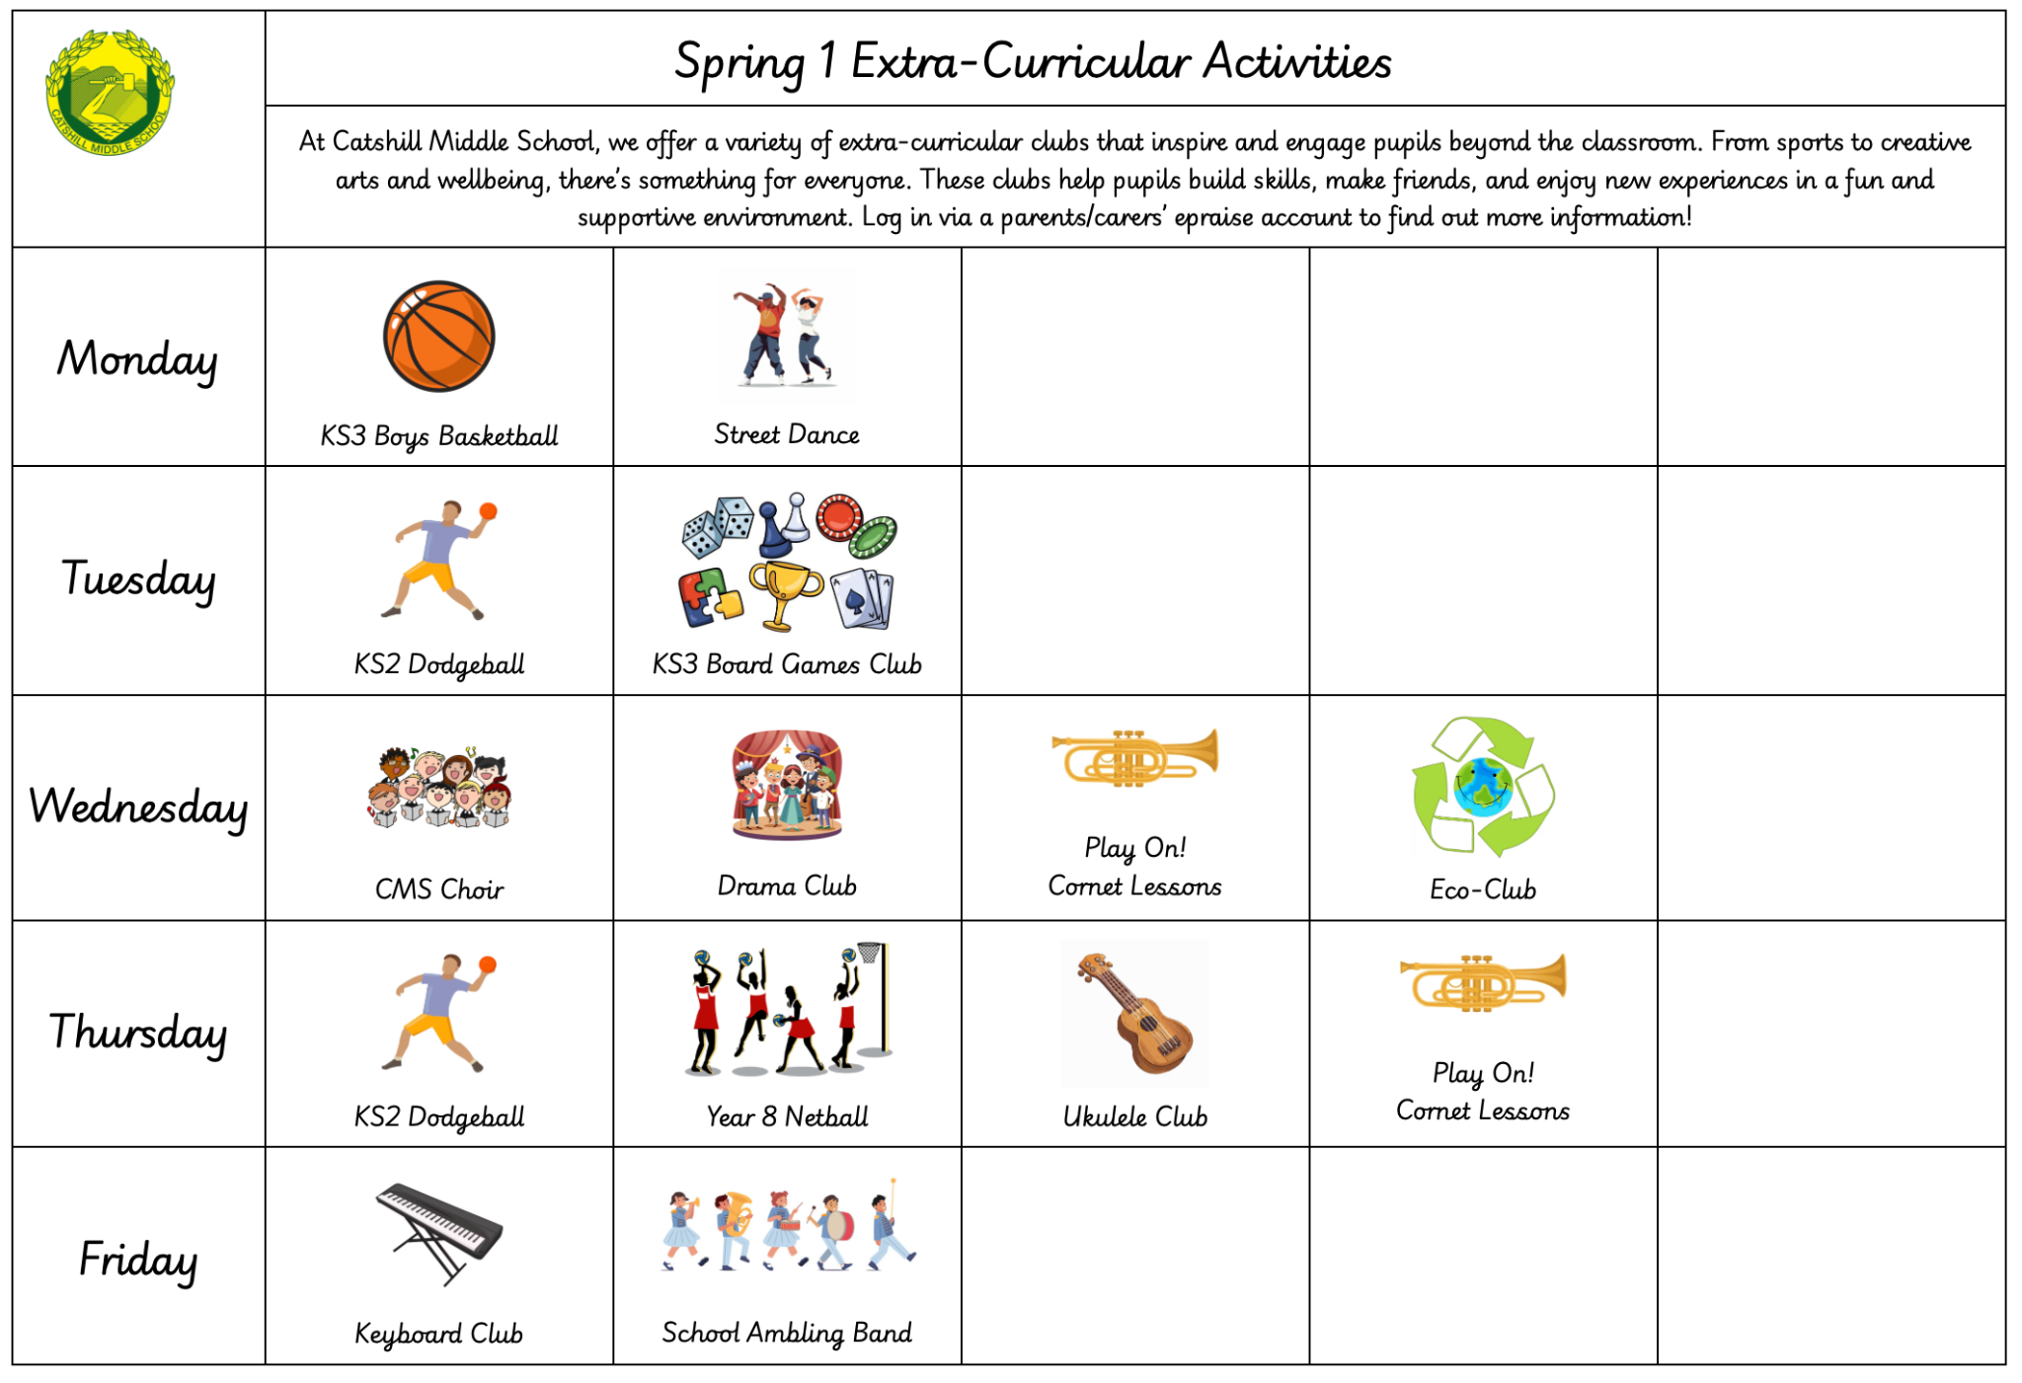

MUSIC
Year 7 will expand their knowledge of Western rhythmic notation whilst listening, appraising and responding to the energetic, exciting, dramatic and polyrhythmic music of Stomp.
CAREERS
HOMEWORK
This term year 7 are going to have an external inspirational speaker come in and do some workshops to build self-awareness, purpose, accountability, resilience, and confidence.
In Year 7, pupils will be set weekly homework. This will include:
A piece of Maths homework
A piece of English homework
Spellings
We also expect pupils to read for a minimum of three times per week at home.
Other subjects will set additional homework to aid learning outside of the classroom when needed. This will be added onto epraise.
EXTRA-CURRICULAR
From sports to creative arts and wellbeing, there’s something for everyone. Clubs help pupils build skills, make friends, and enjoy new experiences in a fun, supportive environment. Log in via a parents/carers’ epraise account to learn more.

