Slide 1








Year 6 Spring 1
CURRICULUM NEWSLETTER
MATHS
SCIENCE
.
During this half term in Year 6, pupils will deepen their understanding of ratio, proportion, fractions, decimals and percentages. Children will be encouraged to explain their thinking clearly and apply mathematical skills to real-life contexts.
We begin by exploring ratio, learning when to add or multiply, using ratio language and symbols, and understanding the links between ratio and fractions. Pupils will apply this knowledge to scale drawings, scale factors and similar shapes, before solving a range of ratio and proportion problems, including those linked to recipes.
Later in the term, pupils will focus on fractions, decimals and percentages. They will explore equivalents, understand percentages as parts of a whole, and confidently convert between forms. Children will also order values and calculate percentages of amounts, including multi-step problems and finding missing values.
This term we will be looking at light. Children name and identify simple parts of the
human eye and discuss their functions in relation to being able to see objects.
Children also explore the idea that some objects emit light while others reflect light. By the end of this step, children should identify that light travels from a light source
to an object, then to the eye.
The concept that light travels in straight lines will be covered in greater detail in later in the term.
ENGLISH
The beginning of the spring term will be spent completing Anthony Horowitz’s novel ‘Stormbreaker’ and composing an original action story.
Our next reading adventure takes us the USA, where we will be following August Pullman’s journey through middle school. Born with facial differences that, up until now, have prevented him from going to a mainstream school, Auggie Pullman becomes the most unlikely of heroes when he enters the local fifth grade. As his family, his new classmates, and the larger community all struggle to discover their compassion and acceptance, Auggie's extraordinary journey will unite them and prove you can't blend in when you were born to stand out.

Slide 2







MFL - SPANISH
In the Spring term, we move onto the topic “El sistema solar” in Spanish. We will begin by learning to name the planets and using key adjectives, describe the planets in Spanish. We will look at larger numbers to describe the planets’ orbits. We will learn how to use the comparative in Spanish and apply this to facts about our solar system. In reading and listening, we will learn to identify key details in an extended text.
HISTORY
During this term, pupils will study WWII causes, daily life, the Battle of Britain, the Blitz through sources, evacuation, women’s roles, children’s experiences, post-war migration, and local stories to understand the conflict’s impact.
GEOGRAPHY
Year 6, pupils will explore How We Live, learning about the different ways people around the world live, work, and meet their needs. They will investigate communities, lifestyles, and cultures, as well as the factors that affect daily life, such as environment, jobs, and resources. This topic encourages pupils to understand and compare life in different places and reflect on their own communities.

Slide 3





P.E
Throughout this half term, Year 6 will be creating their own Haka routine within Dance, using big actions and group freeze frames. They will also combine jumping, rolling and travelling within Gymnastics to create sequences alongside working on the wall bars with a partner.
R.E
DESIGN AND TECHNOLOGY
During this half term, in Year 6, the children will be studying Hinduism. They will be investigating the question ‘Why do Hindus want to be good?’
Year 6 will start this term working on building their jitter toys. Then we will be moving on to the resistant materials project. Picture puzzle is where they will get to design and make their own jigsaw puzzle from wood and learn how to use a range of hand tools.

Slide 4





ART
ART
We will be journeying through art under the topic heading of ‘flight’ allowing us to explore the wonders of the sky. This topic will allow students to develop their drawing skills whilst also using their imagination to allow for maximum creativity and diversity of outcomes. We will begin by looking at the history of flight by creating a timeline before creating tonal studies of creatures of flight and taking inspiration from Leonardo Da Vinci to design our own flying machines
COMPUTING
PSHE & RSE
Audio Production
Learners will work on a Podcast using audacity to edit sounds clips they record. They will plan out their Podcast, thinking about the structure of the Podcast as well as the content. Theme for Podcast to be Staying safe online.
This term, the children will talk about their dreams and goals and look at how they can work with other people to achieve these. They will also look at how to accept praise.

Slide 5
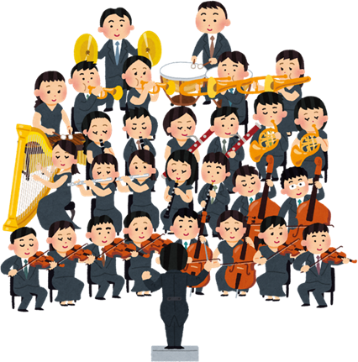
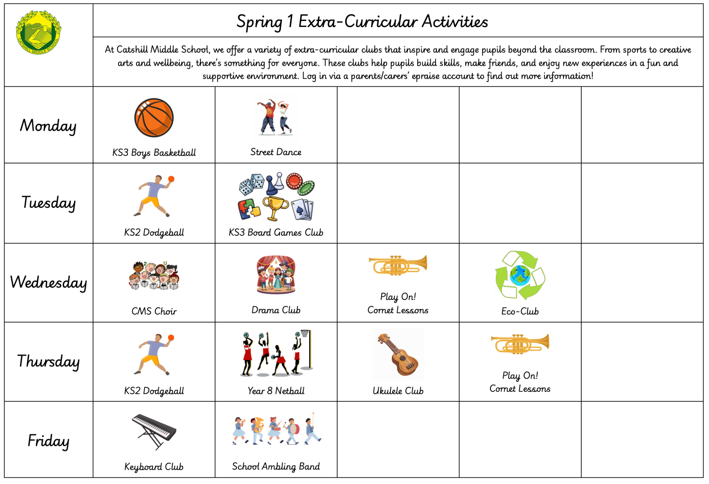

MUSIC
This term 6JB will be learning about the Orchestra. 6AU will be the lucky next class to be taking whole-class cornet lessons. 6SR and 6FB will be learning all about the music from Spain. They will explore Spanish flamenco rhythms, body percussion and improvisation, as well as contrasting it with the lesser known traditional bagpipe music of Galicia. Year 6 also have a music curriculum trip this half term to Symphony Hall to see the CBSO orchestra live.
CAREERS
HOMEWORK
This term we will be having dedicated assemblies talking about the personal skills we need to be successful.
In Year 6, pupils will be set weekly homework. This will include:
A piece of Maths homework
A piece of English homework
Spellings
We also expect pupils to read for a minimum of three times per week at home.
Other subjects will set additional homework to aid learning outside of the classroom when needed. This will be added onto epraise.
EXTRA-CURRICULAR
From sports to creative arts and wellbeing, there’s something for everyone. Clubs help pupils build skills, make friends, and enjoy new experiences in a fun, supportive environment. Log in via a parents/carers’ epraise account to learn more.

