Slide 1








Year 5 Spring 1
CURRICULUM NEWSLETTER
MATHS
SCIENCE
This term in Year 5, we will be developing pupils’ confidence and fluency in multiplication, division and fractions, with regular opportunities to practise, explain their thinking and apply skills to real-life problems.
We begin by strengthening multiplication skills, starting with multiplying 4-digit numbers by 1-digit numbers. Pupils will then progress to multiplying 2-digit numbers by 2-digit numbers, using the area model before moving on to formal written methods. As confidence grows, children will tackle larger calculations, including multiplying 3- and 4-digit numbers by 2-digit numbers, and apply these skills to problem-solving tasks.
The focus then shifts to division, where pupils will practise short division, including dividing 4-digit numbers by 1-digit numbers. Children will learn to work confidently with remainders, explore more efficient strategies and solve problems involving both multiplication and division.
Later in the term, pupils will develop their understanding of fractions as operators. They will multiply fractions and mixed numbers by integers, calculate fractions of amounts, and learn how to find the whole.
.
This term, children test everyday materials and group them based on their transparency, hardness and magnetism.
They also link the properties of materials to their uses.
ENGLISH
Once our Y5 pupils have finished exploring Beverley Naidoo’s novel Journey to Jo’burg, they will begin a new topic. Our poetry topic, ‘The Power of Imagery’ offers pupils the opportunity to study a range of poetic forms, poetic devices and poets. Throughout the unit, they will apply their learning to original poetry of their own.

Slide 2







MFL - SPANISH
This half term we will continue to build on the language learnt in the Autumn term. We will begin by learning how to say if we have siblings and then extend our language to introduce other members of our family. Using our knowledge from term one, we will introduce these people in Spanish using the third person of key verbs. We will also learn about the Spanish royal family.
HISTORY
During this term, pupils will study Tudor monarchs, compare lifestyles, interpret Henry VIII and the Reformation, explore justice and propaganda, analyse and create inventories, and examine Elizabeth I’s reign and its lasting influence.
GEOGRAPHY
Year 5, pupils will study Protecting Our Planet, learning about the importance of caring for the environment. They will explore issues such as pollution, deforestation, and climate change, and discover ways humans can reduce their impact. Pupils will develop an understanding of how they can make a difference locally and globally to help protect the Earth for the future.

Slide 3





P.E
Throughout this half term, Year 5 will be working within groups to develop a dance routine based around a school exam to a well known song. They will also combine jumping, rolling and travelling within Gymnastics to create sequences with a partner, focusing on synchronization and creativity.
R.E
DESIGN AND TECHNOLOGY
During this half term, in Year 5, the children will be studying Judaism. They will be looking at the question ‘Why is the Torah so important to Jewish people?’
During this term, year 5 will be investigating different types of movement and motion by analysing existing toys and explaining how they work. We will then look at making our own moving toy samples using different linkages and levers.

Slide 4





ART
ART
We will be focusing on our drawing skills this term, exploring the topic ‘Natural Forms’. We will be taking inspiration from the natural world to artworks using our observational skills, learning to really look at the things that surround us as we head into Spring. For one of our artworks we will be looking at an artist that uses macro photography to learn about symmetry and the details of some of the smallest creatures.
COMPUTING
PSHE & RSE
Paint.Net
Learners will develop their understanding of how digital images can be changed and edited, and how they can then be saved and reused. Pupils will learn about the benefits and dangers of being able to digitally edit images.
This term, the children will talk about their dreams and goals and look at a range of jobs and salaries. They will also look at how dreams and goals may vary depending on a person’s culture.

Slide 5

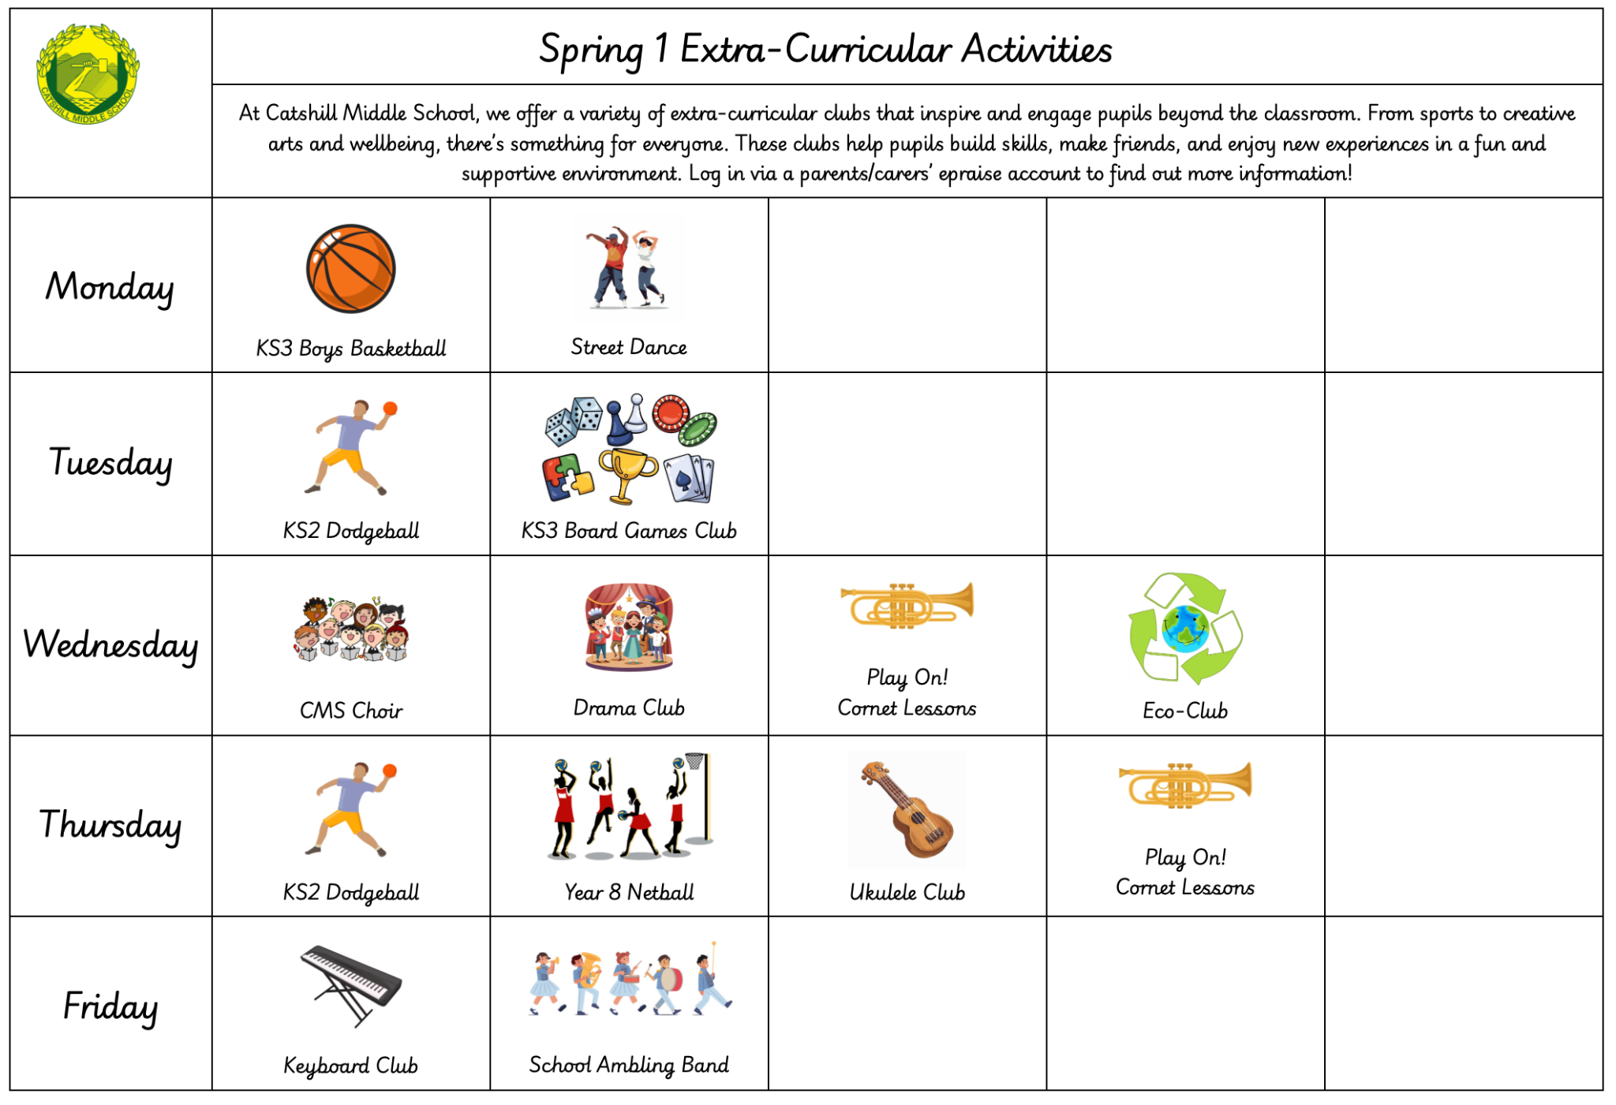

MUSIC
Year 5 are studying Rap music in their first topic of 2026. Children will develop their rhythmic skills, vocal confidence, keyboard skills and song writing skills, whilst exploring the history and context of the hip hop genre.
CAREERS
HOMEWORK
This term we will be having dedicated assemblies talking about the personal skills we need to be successful.
In Year 5, pupils will be set weekly homework. This will include:
A piece of Maths homework
A piece of English homework
Spellings
We also expect pupils to read for a minimum of three times per week at home.
Other subjects will set additional homework to aid learning outside of the classroom when needed. This will be added onto epraise.
EXTRA-CURRICULAR
From sports to creative arts and wellbeing, there’s something for everyone. Clubs help pupils build skills, make friends, and enjoy new experiences in a fun, supportive environment. Log in via a parents/carers’ epraise account to learn more.

