Slide 1
BMSLP – Online Safety Evening
Notes:
Welcome and introductions

Slide 2
Overview
Department for Education update Safeguarding concerns 10 Top Tips Suggested Parent Resources Quiz West Mercia Police

Slide 3
https://assets.publishing.service.gov.uk/government/uploads/system/uploads/attachment_data/file/835733/Keeping_children_safe_in_education_2019.pdf
Notes:
Keeping Children Safe in Education 2019, accessed on the D for E website is a document containing statutory government guidance that sets out the legal duties all staff in education must follow in order to safeguard and promote the welfare of children and young people aged 18 years and under in schools, colleges, and education settings across the United Kingdom.
There is a specific reference to the new guidance ‘Teaching online safety in school’

Slide 4
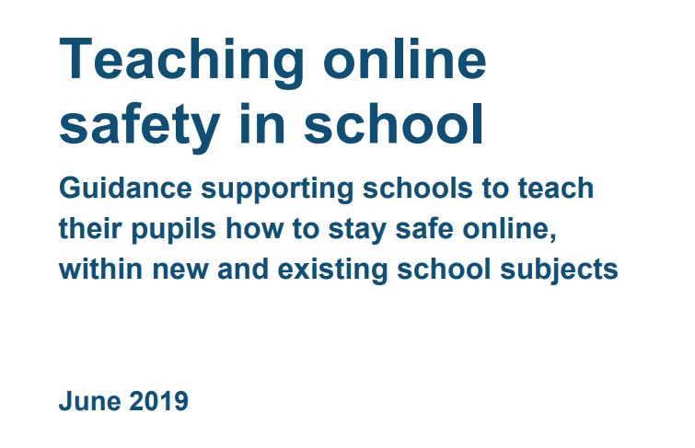
This document outlines guidance supporting schools to teach their pupils how to stay safe online.
Notes:
https://assets.publishing.service.gov.uk/government/uploads/system/uploads/attachment_data/file/811796/Teaching_online_safety_in_school.pdf

Slide 5
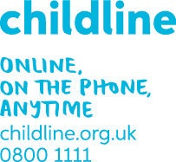
Underpinning knowledge and behaviours include:
How to evaluate what children see online
How to recognise techniques used for persuasion
Online behaviour
How to identify online risks
How and when to seek support
Parents can also help their children by helping them to identify who trusted adults are, looking at the different ways to access support from the school, police, the National Crime Agency’s Click CEOP reporting service for children and 3rd sector organisations such as Childline and Internet Watch Foundation.
Notes:
The online world develops and changes at great speed. New opportunities, challenges and risks are appearing all the time. This can make it difficult for schools to stay up to date with the latest devices, platforms, apps, trends and related threats.
20. It is therefore important to focus on the underpinning knowledge and behaviours that can help pupils to navigate the online world safely and confidently regardless of the device, platform or app. This teaching could be built into existing lessons across the curriculum, covered within specific online safety lessons and/or school wide approaches. Teaching must always be age and developmentally appropriate.
How to evaluate what they see online - This will enable pupils to make judgements about what they see online and not automatically assume that what they see is true, valid or acceptable.
How to recognise techniques used for persuasion – This will enable pupils to recognise the techniques that are often used to persuade or manipulate others. Understanding that a strong grasp of knowledge across many areas makes people less vulnerable to these techniques and better equipped to recognise and respond appropriately to strongly biased intent or malicious activity.
Online behaviour – This will enable pupils to understand what acceptable and unacceptable online behaviour look like. Schools should teach pupils that the same standard of behaviour and honesty apply on and offline, including the importance of respect for others. Schools should also teach pupils to recognise unacceptable behaviour in others.
How to identify online risks – This will enable pupils to identify possible online risks and make informed decisions about how to act. This should not be about providing a list of what not to do online. The focus should be to help pupils assess a situation, think through the consequences of acting in different ways and decide on the best course of action.
How and when to seek support – This will enable pupils to understand safe ways in which to seek support if they are concerned or upset by something they have seen online.

Slide 6
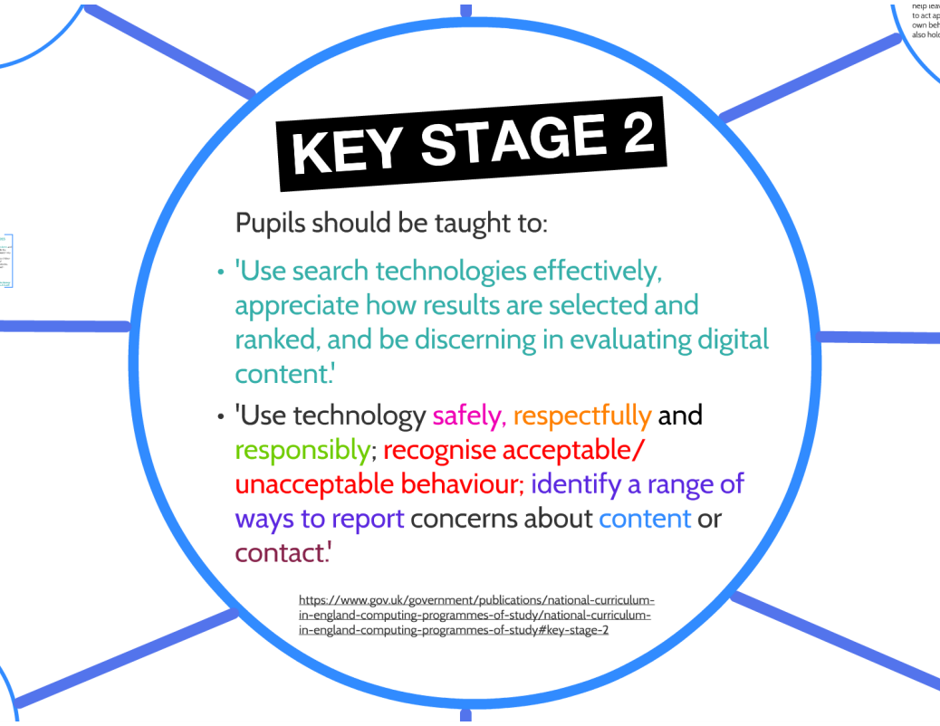
Key learning
Notes:
https://www.childnet.com/ufiles/Childnet-Online-Safety-Computing-KS2-0916.pdf
By the end of Key Stage 2 pupils should be able to use technology safely, respectfully and responsibly. Students should recognise acceptable/unacceptable behaviour as well as identifying a range of ways to report concerns.

Slide 7
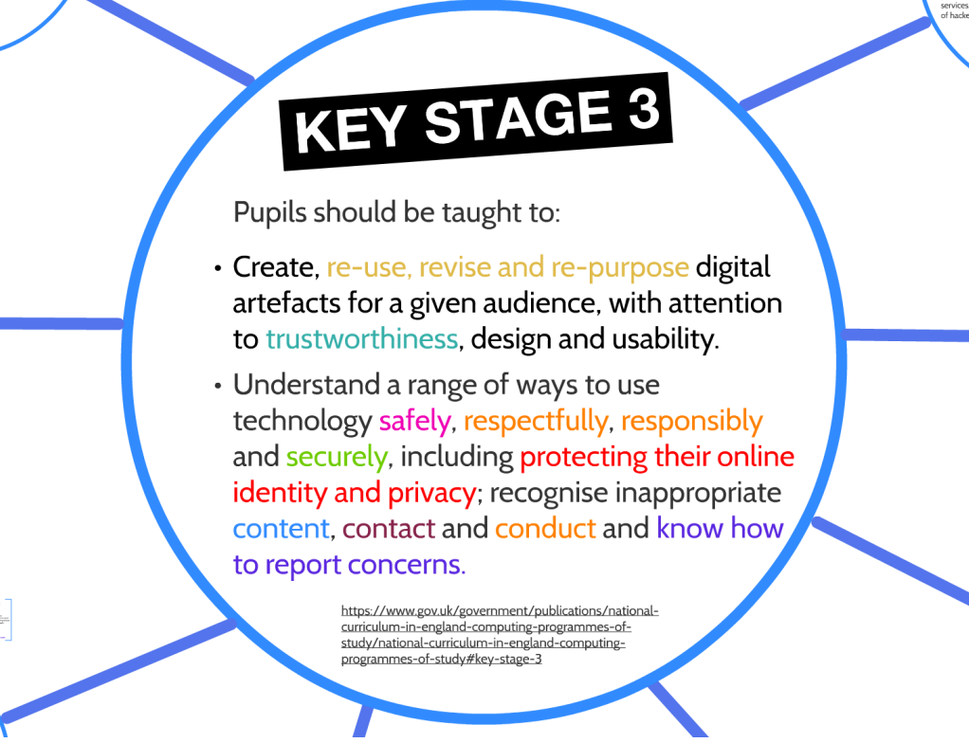
Key learning
Notes:
By the end of Key Stage 3 pupils should be able to understand a range of ways to use technology safely, responsibly, and securely. Including protecting their online identity and privacy.

Slide 8
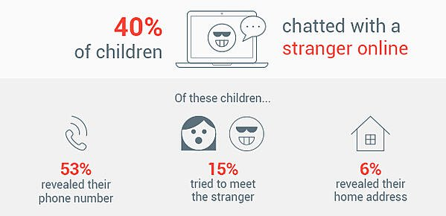
What Kids Do Online May Surprise You!
Internet Safety Tips for You and Your Child
29% are using the internet in ways their parents won’t approve
21% visit sites where they can chat with strangers
17% are visiting sites with sexual photos or adult videos
11% are visiting sites with instructions for cheating on schoolwork
4% are visiting gambling sites (little Timmy can count cards??)
Source: https://iamcybersafe.org/parent-research/
Notes:
Just like teaching a child to ride a bike or cross the road, digital resilience is another way to highlight the need to help children cope with whatever the online world throws at them. Digital resilience is a key skill that we want young people to develop. Whilst going online can be incredibly fun and enjoyable there can also be times when a young person can feel upset, not good enough or left out.

Slide 9
What apps are your children using?
Notes:
Some online activities have age restrictions because they include content which is not appropriate for children under a specific age.
It’s important that we understand the age of digital consent- the minimum age (13) at which young people can agree to share information and sign up to social media without parental consent under General Data Protection Regulations.

Slide 10
Digital footprint
The things you put online can be seen by lots of people and might stay online forever. They are like digital footprints – a trail that people can follow, picking up pieces of information about you.
We all leave digital footprints and with every new profile, photo or comment we add new ones. People that you know, and people you don’t, can learn a lot from them. Do you know what yours say about you?
Your footprints can show you at your very best or very worst. Lots of people, like YouTuber Jack Maynard, are finding out that our posts can have serious consequences long after we’ve forgotten them.
This is one reason why to use most sites you can share information on you need to be over 13.
http://www.policeandschools.org.uk/KNOWLEDGE%20BASE/online_safety_primary.html
Notes:
YouTuber Jack Maynard was accused of racism and homophobia in some old tweets which he wrote back in 2012. The tweets, which have been deleted, resurfaced online while he was in the I’m a Celebrity Jungle show.
Watch video: http://www.policeandschools.org.uk/KNOWLEDGE%20BASE/online_safety_primary.html – scroll down to LIVE MY DIGITAL … video clip. DIGITAL FOOTPRINT ( 4mins approx.)

Slide 11
Fake websites and scam emails
Fake websites and scam emails are used to extort data, money, images and other things that can either be used by the scammer to harm the person targeted or sold on for financial, or other gain.
Fraud can take place online and can have serious consequences for individuals and organisations
Password phishing is the process by which people try to find out your passwords so they can access protected content
Online platforms and search engines gather personal data. This is often referred to as ‘harvesting’ or ‘farming’.

Slide 12
The potential harms or risk
Abuse (online) - online abuse can be sexual, harassment, bullying, trolling and intimidation.
Be aware that online abuse can cross a line and become illegal, such as forms of hate crime and blackmail.
Fake profiles - Not everyone online is who they say they are. In some cases profiles may be people posing as someone they aren’t (i.e. an adult posing as a child) or may be “bots” (which are automated software programs designed to create and control fake social media accounts).
Grooming - Make sure you know about the different types of grooming and motivations for it, for example radicalisation, Child Sexual Abuse and Exploitation (CSAE) and gangs (county lines).
See the NCA-CEOP Thinkuknow website for further information on keeping children safe from sexual abuse and exploitation.
https://www.youtube.com/watch?v=Zyux6NGxRYk
Notes:
Some online behaviours are abusive. They are negative in nature, potentially harmful and in some cases can be illegal.
look out for fake profiles:
This could include
profile pictures that don’t like right, for example of a celebrity or object,
accounts with no followers
or thousands of followers; and
a public figure who doesn’t have a verified account
As children continue to find new ways to connect with each other on a range of devices and platforms it is increasingly important to help them make smarter and safer choices about who they talk to and what they share online, especially with an increase of groomers online.
There’s a chance that your child may meet people online that aren’t who they say they are. Grooming is a word used to describe people befriending children in order to take advantage of them for sexual purposes. Many parents worry about online grooming so it’s important to talk to your children about how to stay safe. It’s easy to pretend to be someone else on the internet, frequently known as online impersonation. Children can sometimes end up having conversations with people whose real identities they may not know.
Groomers may go to a social network used by young people and pretend to be one of them. They might attempt to gain trust by using fake profile pictures, pretending to have similar interests, offering gifts and saying nice things to the child.
Groomers build trust between themselves and the child’
Once they have the child’s trust the groomer often steers the conversation towards their sexual experiences, even asking them to send sexual photographs or videos of themselves. Some may try to set up a meeting or even blackmail children by threatening to share the pictures or videos with the child’s family and friends.
Existing relationships may be exploited by a groomer
Online groomers are not always strangers. In many situations, they may already have met them through their family or social activities, and use the internet to build rapport with them. Sometimes children don’t realise they’ve been groomed, and think that the person is their boyfriend or girlfriend.
Where can online grooming happen?
Online groomers will target children on sites and platforms that are popular with young people. On social media, online groomers will often target a number of young people at any one time by sending out friend requests to see who responds. Through online forums and online games, they may strike up a conversation to build a relationship with a child and ask them to continue the talking on another platform or chat privately.
Video: Click hyperlink
https://www.youtube.com/watch?v=Zyux6NGxRYk 8 minutes approx

Slide 13
Warn your child to look out for… It’s impossible to know if someone you meet online is genuine or a fake. Here are 5 warning signs:
Too good to be true? Do they like all the same things as you and give you loads of attention? Are they really nice about things you post like photos?
Giving presents and making promises. Do they make promises or offer you gifts if you will do things for them? Giving gifts and making promises can be a way of putting pressure on you.
Putting you under pressure. Do they try to talk about things you’re not comfortable with, like sex? Do they ask for pictures of you that you wouldn’t share with your mum or your teacher?
Leaving public places. Have they asked to ‘private message’ or to add you on a social network or mobile app? Ask yourself, why do they need to chat in private? Games, chatrooms or forums are usually ‘public places’ where other people can see your conversations.
‘Just our little secret’. Do they tell you to keep your chat secret? Do they say you’ll be in trouble if you don’t? If they ask you to keep secrets they might be trying to stop you from getting help if things get weird or you feel uncomfortable. You shouldn’t keep secrets for people you meet online

Slide 14
10 tips for keeping your children safe online
1
Have a conversation with your kids!
Kids are getting their first internet-connected gadgets at pretty young ages. So start talking to them early.
Warn them about malware (malicious software), dangerous websites, and sex offenders.
Let your kids know you’re looking out for them, speak honestly with them, and listen.
Notes:
Here are 10 top tips for keeping your children safe online.
1
Have a conversation with your kids!
Kids are getting their first internet-connected gadgets at pretty young ages. So start talking to them early.
Warn them about malware (malicious software), dangerous websites, and sex offenders.
Let your kids know you’re looking out for them, speak honestly with them, and listen.

Slide 15
10 tips for keeping your children safe online
2
Keep your computer in a common area of the house
It's more difficult for sex offenders and online bullies to harass your child when you can see what your child is up to. So make sure your kids aren’t going to bed with their laptops, gaming device and phones. Keep internet time in the common areas.
Notes:
2
Keep your computer in a common area of the house
It's more difficult for sex offenders and online bullies to harass your child when you can see what your child is up to. So make sure your kids aren’t going to bed with their laptops and phones. Keep internet time in the common areas.

Slide 16
10 tips for keeping your children safe online
3
Know which other computers your children are using
Your children most likely have access to computers at school or their friends' houses.
Ask them where they go online, and talk to their friends’ parents about how they supervise their own kids’ internet use.
Notes:
3
Know which other computers your children are using
Your children most likely have access to computers at school or their friends' houses.
Ask them where they go online, and talk to their friends’ parents about how they supervise their own kids’ internet use.

Slide 17
10 tips for keeping your children safe online
4
Remind your children, "Don't talk to strangers — or meet them“
Make it clear that online strangers are not friends. Remind your children that people often lie about their age, and online predators often pretend to be children.
Emphasize that your children should never reveal personal information like their name, address, phone number, school name, or even their friends’ names. Knowing any of this could help an online predator find your kid in real life.
And under no circumstances should your child ever meet up with someone they met online without your permission. If you do agree to a meeting, go with your child and meet in a public place.
Becky’s Story- https://www.teachertube.com/videos/jigsaw-8-10s-147297
Guy Fawkes finds sharing personal information over the internet can leave you in trouble https://www.bbc.co.uk/cbbc/watch/p01g2pt6
Notes:
https://www.bbc.co.uk/cbbc/watch/p01g2pt6 – Guy Falkes- Protect your privacy settings
4
Remind your children, "Don't talk to strangers — or meet them“
Make it clear that online strangers are not friends. Remind your children that people often lie about their age, and online predators often pretend to be children.
Emphasize that your children should never reveal personal information like their name, address, phone number, school name, or even their friends’ names. Knowing any of this could help an online predator find your kid in real life.
And under no circumstances should your child ever meet up with someone they met online without your permission. If you do agree to a meeting, go with your child and meet in a public place.

Slide 18
10 tips for keeping your children safe online
5
Make internet time family time
You watch movies together.
Why not browse the web together?
Making it a family event can be fun.
Notes:
5
Make internet time family time
You watch movies together.
Why not browse the web together?
Making it a family event can be fun.

Slide 19
10 tips for keeping your children safe online
6
Know your children's passwords
If you’ve got a younger child, create an account for them in your own name to avoid exposing your kid’s name — and so you’ll have the password.
But please respect the age limitations on accounts. If a site says you should be 18 to sign up, then maybe your child should wait.
Notes:
https://howsecureismypassword.net/
6
Know your children's passwords
If you’ve got a younger child, create an account for them in your own name to avoid exposing your kid’s name — and so you’ll have the password.
But please respect the age limitations on accounts. If a site says you should be 18 to sign up, then maybe your child should wait.

Slide 20
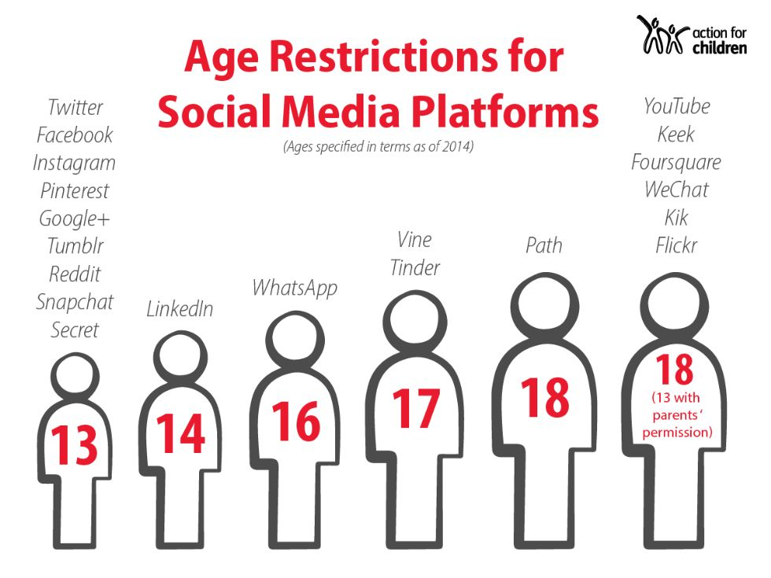

Slide 21
10 tips for keeping your children safe online
7
Watch for changes in your children’s behaviour
Being secretive about what they do online, withdrawing from the family, and other personality changes could be signs that an online sex offender is preying on your child or that they are in trouble online.
So keep an eye out for any behavioural changes.
Notes:
7
Watch for changes in your children’s behaviour
Being secretive about what they do online, withdrawing from the family, and other personality changes could be signs that an online sex offender is preying on your child or that they are in trouble online.
So keep an eye out for any behavioural changes.

Slide 22
10 tips for keeping your children safe online
8
Pay attention to any gifts anyone gives your children
Sexual predators may send physical letters, photos, or gifts to children to seduce them. Stay alert, and ask your children about any new toys or belongings they bring home.
Notes:
8
Pay attention to any gifts anyone gives your children
Sexual predators may send physical letters, photos, or gifts to children to seduce them. Stay alert, and ask your children about any new toys or belongings they bring home.

Slide 23
10 tips for keeping your children safe online
9
Check your children’s browsing history
Open your child’s web browser and look for “History” to see a list of websites they’ve been to.
Also check the recycle bin to see if any files have been deleted. You may be surprised.
Demonstration
Notes:
9
Check your children’s browsing history
Open your child’s web browser and look for “History” to see a list of websites they’ve been to.
Also check the recycle bin to see if any files have been deleted. You may be surprised.

Slide 25
10 tips for keeping your children safe online
10
Set rules — and stick to them
As a parent, it’s your job to limit your kids’ screen time, set boundaries for inappropriate content, and make sure your children stick to them.
Talk to your internet service provider about filters you can use to block pornographic or violent websites, or invest in a Wi-Fi router with parental controls.
Notes:
10
Set rules — and stick to them
As a parent, it’s your job to limit your kids’ screen time, set boundaries for inappropriate content, and make sure your children stick to them.
Talk to your internet service provider about filters you can use to block pornographic or violent websites, or invest in a Wi-Fi router with parental controls.

Slide 26
Sexting
90% of 16-24 year olds and 69% of 12-15 year olds own a smartphone,
giving them the ability to quickly and easily create and share photos and videos.
Creating and sharing sexual photos and videos of under-18s is illegal and therefore causes the greatest complexity for schools and other agencies when responding. It also
presents a range of risks which need careful management.
Types of incident:
• A person under the age of 18 creates and shares sexual imagery of
themselves with a peer under the age of 18
• A person under the age of 18 shares sexual imagery created by another
person under the age of 18 with a peer under the age of 18 or an adult
• A person under the age of 18 is in possession of sexual imagery created by
another person under the age of 18
http://www.policeandschools.org.uk/KNOWLEDGE%20BASE/online%20safety.html
Notes:
Keeping Children Safe in Education statutory guidance sets out that all schools should have an effective child protection policy. Youth produced sexual imagery and a school’s
approach to it should be reflected in the policy.
All incidents involving youth produced sexual imagery should be responded to in line with the school’s safeguarding and child protection policy.
When an incident involving youth produced sexual imagery comes to a school or college’s attention:
• The incident should be referred to the DSL as soon as possible
• The DSL should hold an initial review meeting with appropriate school staff
• There should be subsequent interviews with the young people involved (if
appropriate)
• Parents should be informed at an early stage and involved in the process unless
there is good reason to believe that involving parents would put the young person
at risk of harm
• At any point in the process if there is a concern a young person has been harmed
or is at risk of harm a referral should be made to children’s social care and/or the
police immediately.
An immediate referral to police and/or children’s social care16 should be made if at
this initial stage:
1. The incident involves an adult
2. There is reason to believe that a young person has been coerced, blackmailed or
groomed, or if there are concerns about their capacity to consent (for example
owing to special educational needs)
3. What you know about the imagery suggests the content depicts sexual acts
which are unusual for the young person’s developmental stage, or are violent
4. The imagery involves sexual acts and any pupil in the imagery is under 1317
5. You have reason to believe a pupil or pupil is at immediate risk of harm owing
to the sharing of the imagery, for example, the young person is presenting as
suicidal or self-harming
If any devices need to be seized and passed onto the police then the device(s) should be confiscated18 and the police should be called. The device should be turned off and placed under lock and key until the police are able to come and
retrieve it.
http://www.policeandschools.org.uk/KNOWLEDGE%20BASE/online%20safety.html video clip 5.30 minutes

Slide 27
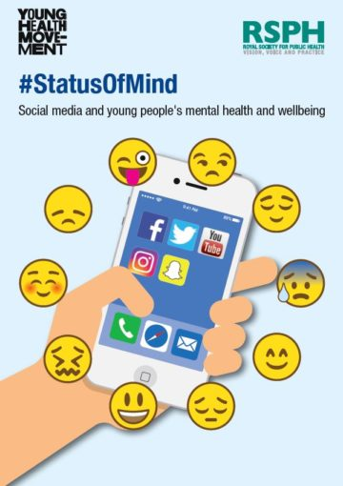
Health, well-being and lifestyle
Statistics from the BBC suggest 78% of children aged 10 to 12 in the UK currently have social media accounts, despite the fact that many networks have a minimum age limit of 13.
A survey conducted by the Royal Society for Public Health asked 14-24 year olds in the UK how social media platforms impacted their health and wellbeing. The survey results found that Snapchat, Facebook, Twitter and Instagram all led to increased feelings of depression, anxiety, poor body image and loneliness.
.
Notes:
In May 2017, Royal Society for Public Health and the Young Health Movement published a report examining the positive and negative effects of social media on young people’s health
The report includes a league table of social media platforms according to their impact on young people’s mental health. YouTube topped the table as the most positive, with Instagram and Snapchat coming out as the most detrimental to young people’s mental health and wellbeing.
There are several theories why social media use may have such negative effects on children. Being constantly exposed to highly idealised representations of people on social media may lead children and young people to think others are happier, more attractive and more successful than they are, making them dissatisfied with their own lives. The more time children spend on social media, the higher their risk is of being exposed to cyber bullying and other negative behaviours, which can lead to low mood and depression.
There is evidence that children who are frequent users of social media are less happy with how they look.
Children who use social media for more than 3 hours a day are more likely to argue with their parents than non-users. Being a heavy social media user may also make your child twice as likely to play truant from school and misbehave in class.
children are experiencing increasing pressures from social media and cyberbullying, causing low self-esteem and unhappiness

Slide 28
Let’s Quiz!
You will see the question on my screen and the answer choices will be on your screen!
Google Kahoot
Enter the game pin
Enter your name

Slide 29
West Mercia Police
PC Kelso
Notes:
Hand over to PC Barney Kelso

